Slide 1







ANALYSIS OF
VECTOR BORNE DISEASES AND CURABILITY
FACILITIES
ACROSS INDIA
DATA VISUALISATION
CSE3004
SUBMITTED TO - DR. ANKUR JAIN

Slide 2






Group Members
MANAS SHUKLA MUDITA SINGH .B FAHAD USMANI CHETAN GARG MANSURIYA RAJ .K
(20MIM10003) (20MIM10024) (20MIM10083) (20MIM10146) (20MIM10147)

Slide 3





Topic Outline
INTRODUCTION OBJECTIVE METHODOLOGY IMPLEMENTATION: DISEASE 1-MALARIA DISEASE 2-JAPANESE ENCEPHALITIS DISEASE 3-DENGUE
DISEASE 4-CHIKUNGUNYA DASHBOARD CONCLUSION

Slide 4
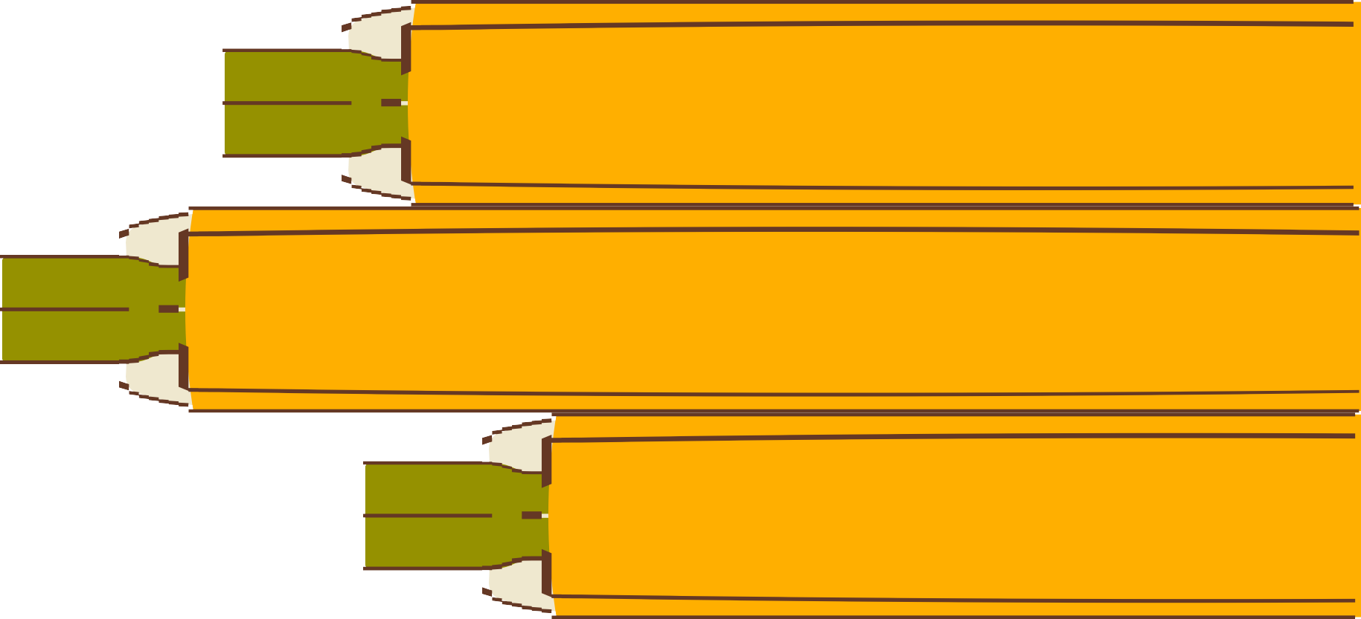
Introduction

Slide 5


Introduction
VECTOR-BORNE DISEASES (VBDS) TRANSMITTED BY MOSQUITOES AND OTHER VECTORS.
MORBIDITY AND MORTALITY MALARIA, DENGUE, CHIKUNGUNYA, JAPANESE ENCEPHALITIS (JE)

Slide 6

Objective

Slide 7
OBJECTIVE
PARAMETERS:
YEAR-WISE DISTRIBUTION OF PATIENTS
STATE WISE DISTRIBUTION
Visualize the
number of cases,
fatalities, severity,
and treatment
facilities present throughout India.

Slide 8







Methodology

Slide 9






Methodology
Data collected from government sources Malaria, Dengue, Chikungunya, Japanese Encephalitis
Total number of cases of that disease, number of samples collected, number of positive cases, number of deaths and the year in which it was reported.

Slide 10


Methodology
Relationship between the various attributes. Determine which disease had the most impact on which state of India.
Will help the higher authorities to take measures.

Slide 11







Implementation

Slide 12

DATA CLEANING

Slide 13
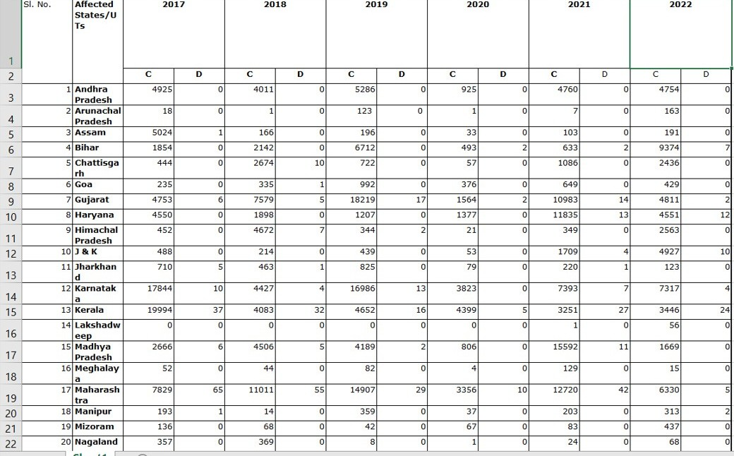
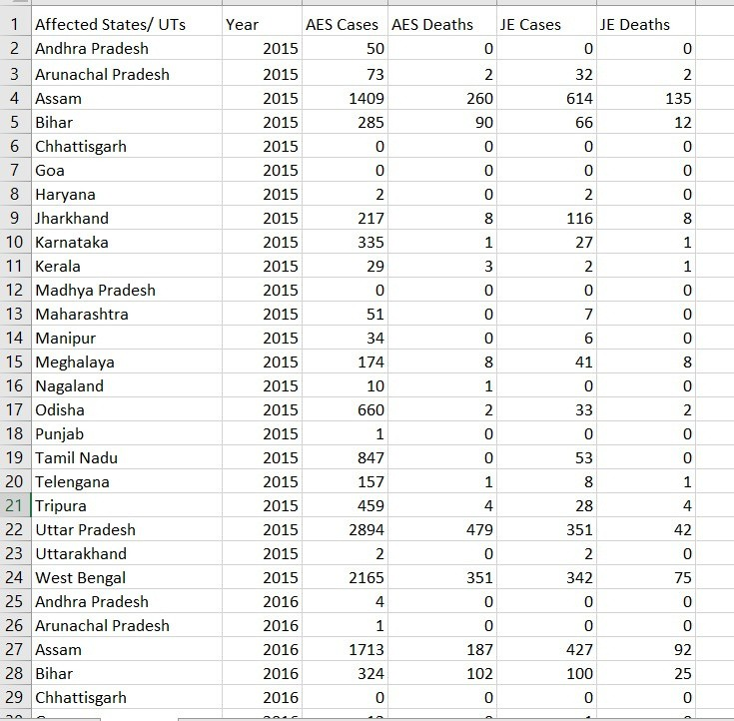


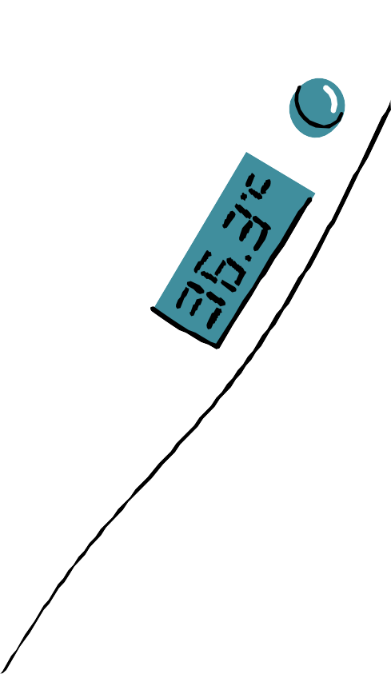
AFTER
BEFORE

Slide 14
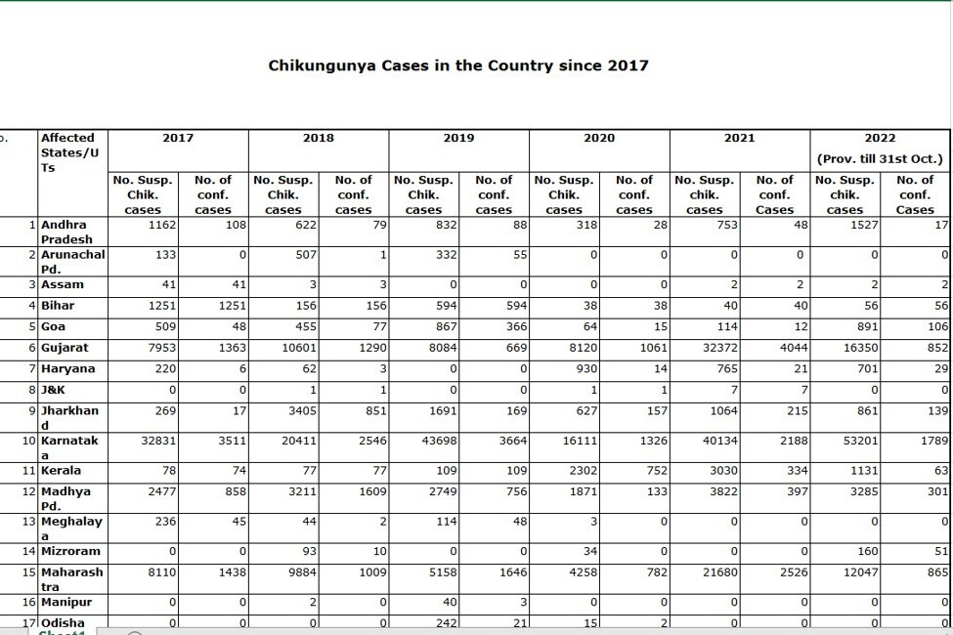
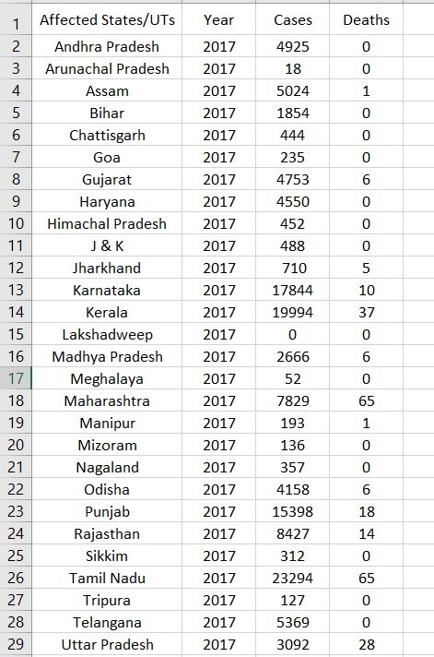


AFTER
BEFORE

Slide 15
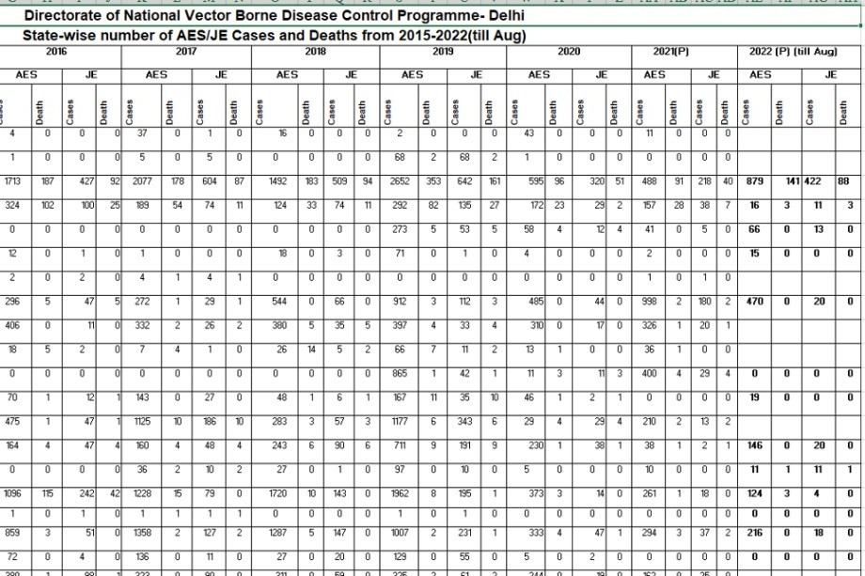
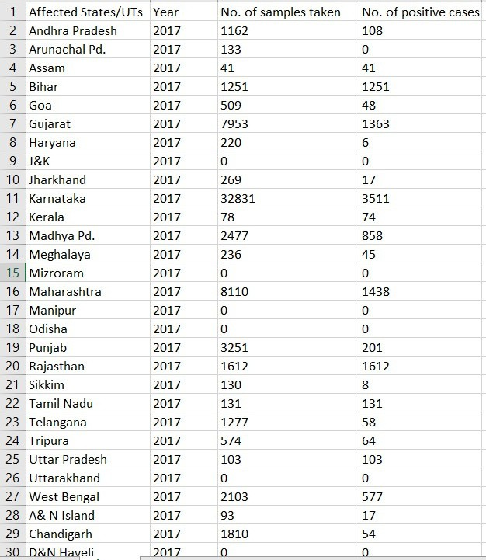



AFTER
BEFORE

Slide 16
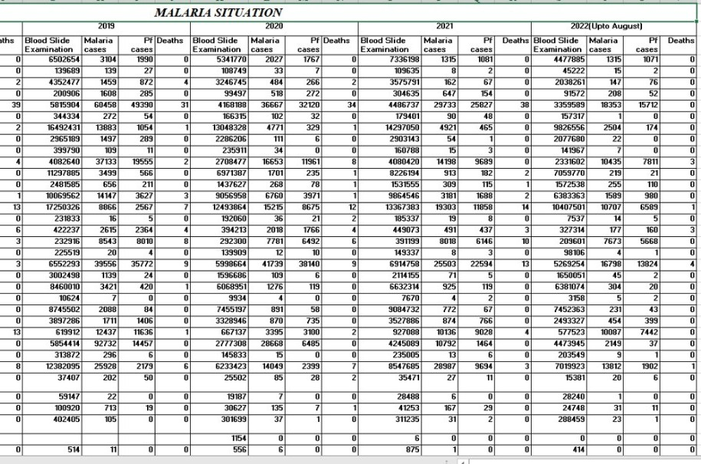
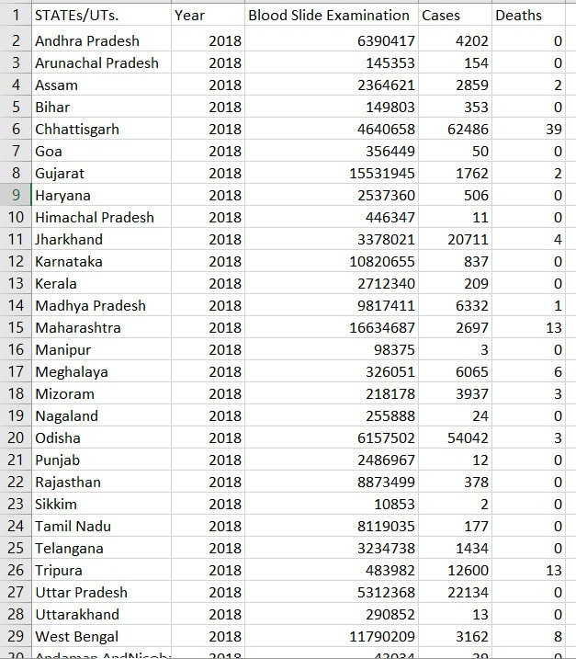

BEFORE
AFTER

Slide 17


Implementation
Recurrent fever with chill and headache. In severe cases it can progress to coma or even death.
occurs throughout the year across the country.
According to World Health Organization (WHO), India contributes 77% of the total malaria cases in Southeast Asia.
DISEASE 1 - MALARIA

Slide 18




Total number of blood samples taken for
Malaria
Total number of Blood samples taken in India: 55,66,66,663
Maximum in: Maharashtra
(7,01,53,761)

Slide 19


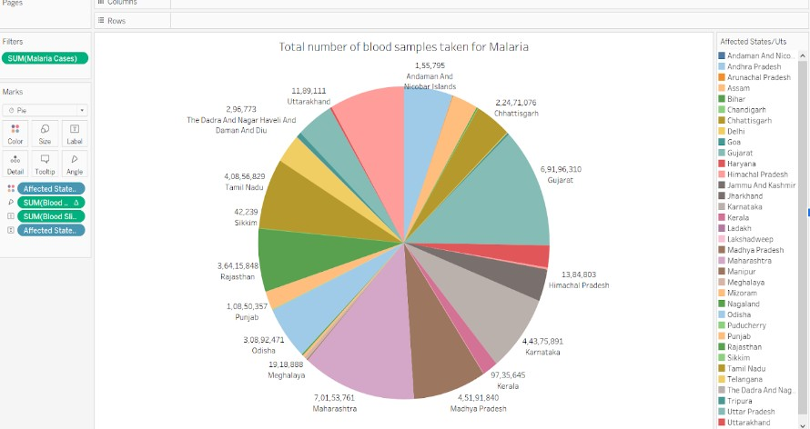


Slide 20



Total number of positive
cases of Malaria
Maximum Cases recorded in:
-Chhattisgarh (1,85,535)
Total number of positive cases of Malaria from
2018 to 2022
Total no. of cases recorded in india in 2018 : - 2,07,181
Total no. of cases recorded in india in 2022 : -62,123

Slide 21


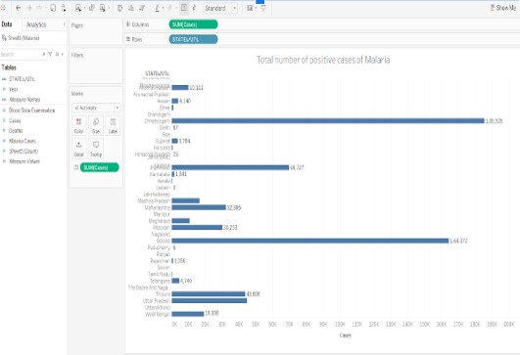


Slide 22


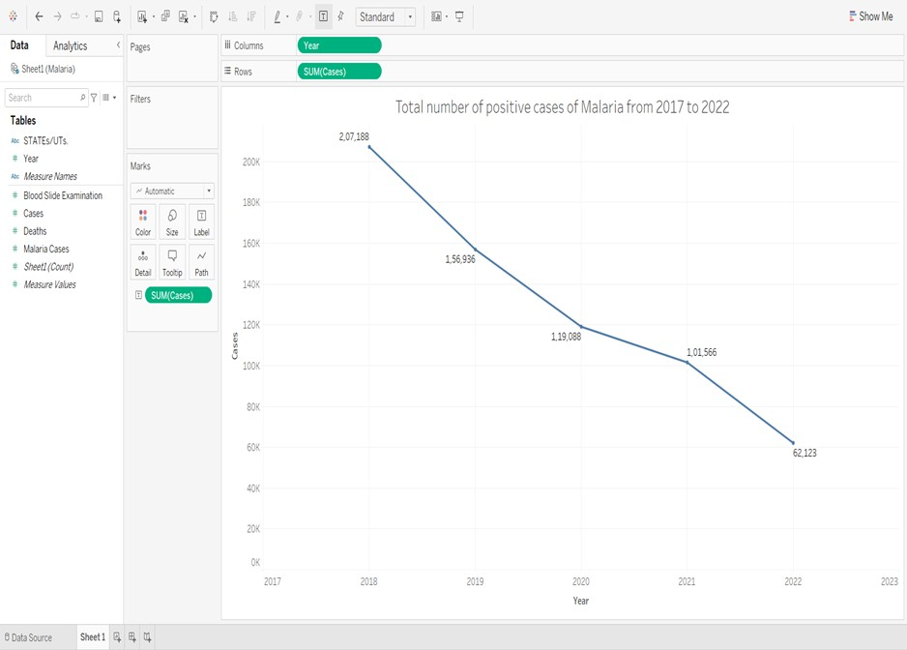


Slide 23





Total number of
Total number of
deaths due to
deaths due to
Malaria
Malaria from 2018
to 2022
Total no. of deaths recorded in india in 2018: 95
Total no. of deaths recorded in india in 2022: - 12
Maximum deaths recorded in: - Chhattisgarh (142)

Slide 24


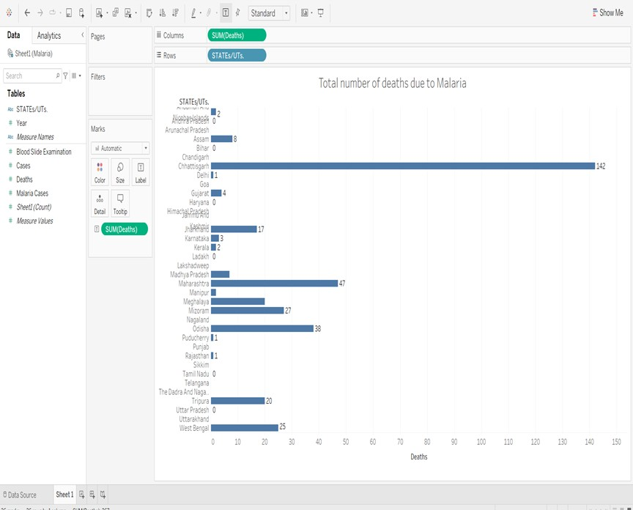

Slide 25


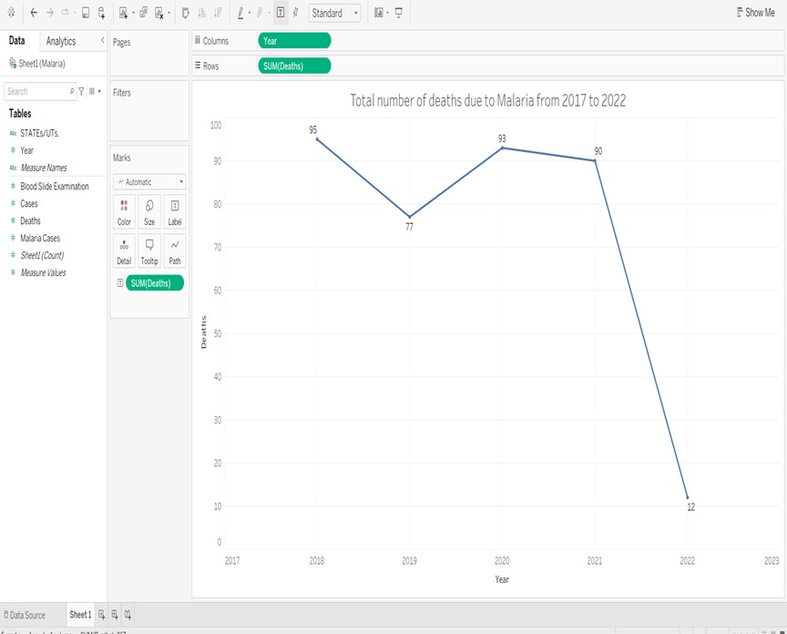

Slide 26



Implementation
Mosquito borne zoonotic viral disease 24 countries of Southeast Asia and Western Pacific region.
Mainly prevalent in the states of Assam, Uttar Pradesh, West Bengal and Odisha.
DISEASE 2 - Japanese
Encephalitis

Slide 27




Total number of cases of Japanese Encephalitis
Maximum Cases recorded in: - Assam (3,334)
Total number of cases of Japanese Encephalitis from 2015 to 2021
Total no. of cases recorded in india in 2015: - 1,730
Total no. of cases recorded in india in 2021: - 787

Slide 28


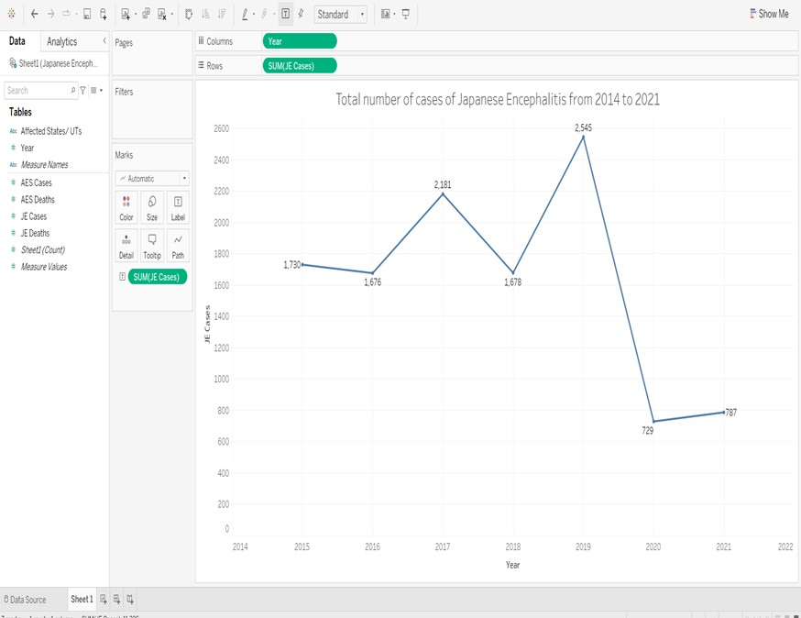


Slide 29




Total number of deaths due to Japanese Encephalitis
Maximum deaths recorded in: - Assam (660)
Total number of deaths due to Japanese Encephalitis from 2015 to 2021
Total no. of deaths recorded in india in 2015: - 291
Total no. of deaths recorded in india in 2021: - 70

Slide 30
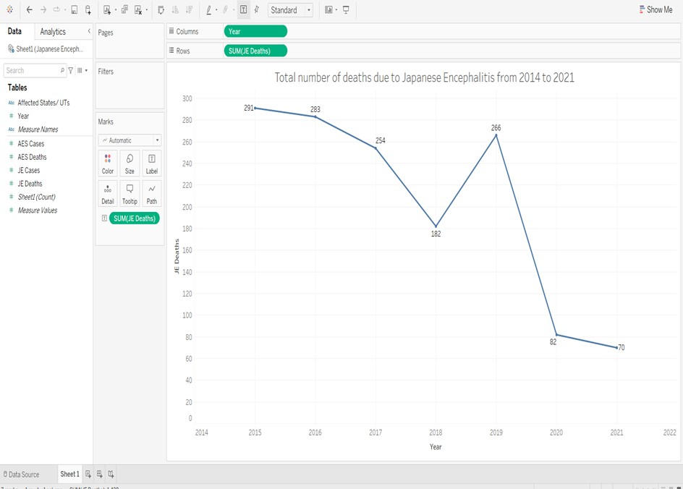

Slide 31


Implementation
Dengue is a viral disease.
Africa, the Americas, South-East Asia and the Western Pacific.
Prevalent are Delhi followed by Punjab, Haryana, West Bengal, Gujarat , Karnataka, Maharashtra, Madhya Pradesh and other states.
DISEASE 3 - Dengue

Slide 32


Total number of cases of Dengue
Maximum Cases recorded in: - Punjab (77,630)
Total number of cases of Dengue from 2017 to 2022
Total no. of cases recorded in india in 2017: -
1,88,401
Total no. of cases recorded in india in 2022: - 1,10,335

Slide 33
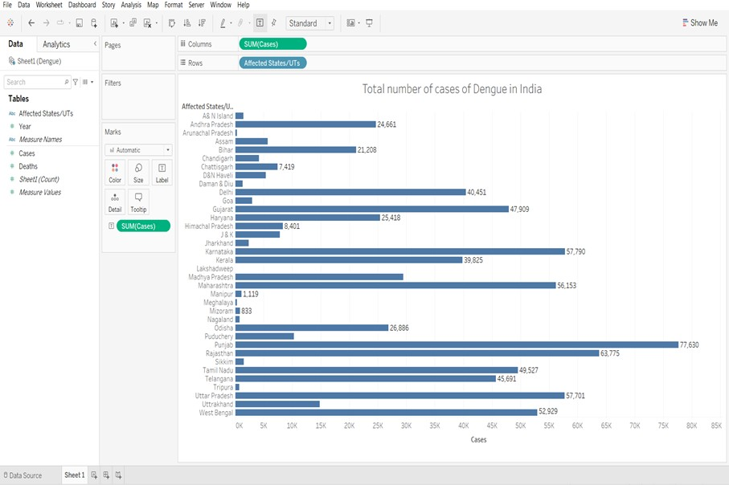

Slide 34
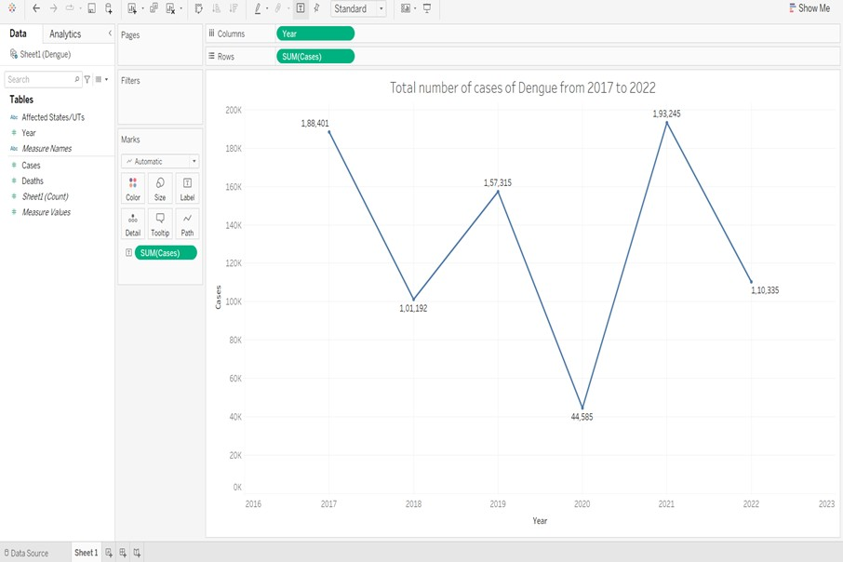

Slide 35



Total number of deaths due to Dengue Maximum deaths recorded in: - Maharashtra (206)
Total number of deaths due to Dengue from 2017 to 2022
Total no. of deaths recorded in india in 2017: - 325
Total no. of deaths recorded in india in 2022: - 86

Slide 36


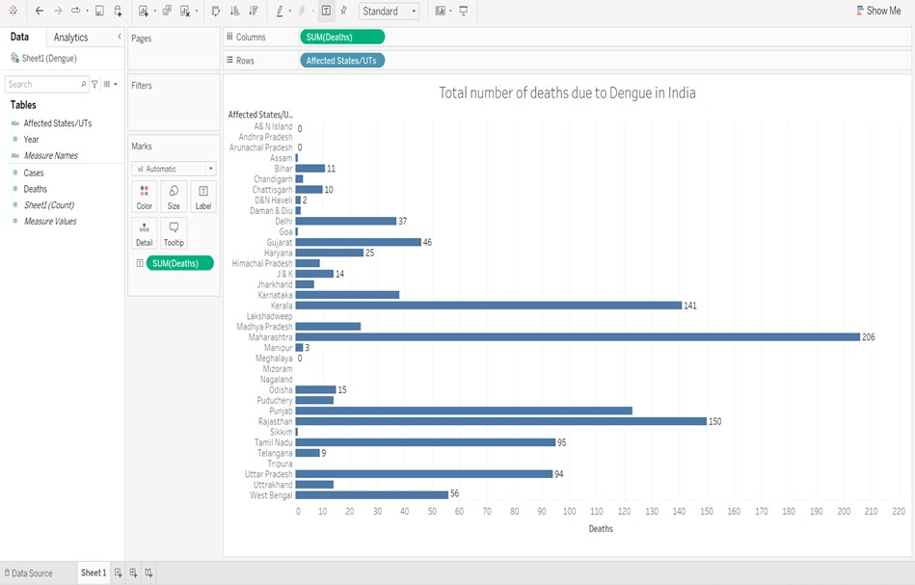

Slide 37


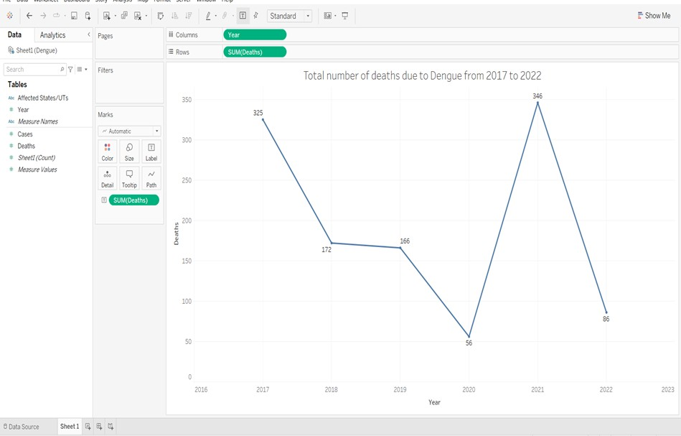

Slide 38



Implementation
Chikungunya is a non-fatal, viral illness Africa, India and Southeast Asia Andhra Pradesh, Karnataka, Maharashtra, Madhya Pradesh, Tamil Nadu, Gujarat & Kerala.
DISEASE 4 - Chikungunya

Slide 39




Total number of samples recorded for Chikungunya
Total number of samples recorded in India: - 3,71,521
Maximum in: - Karnataka (2,06,386)

Slide 40


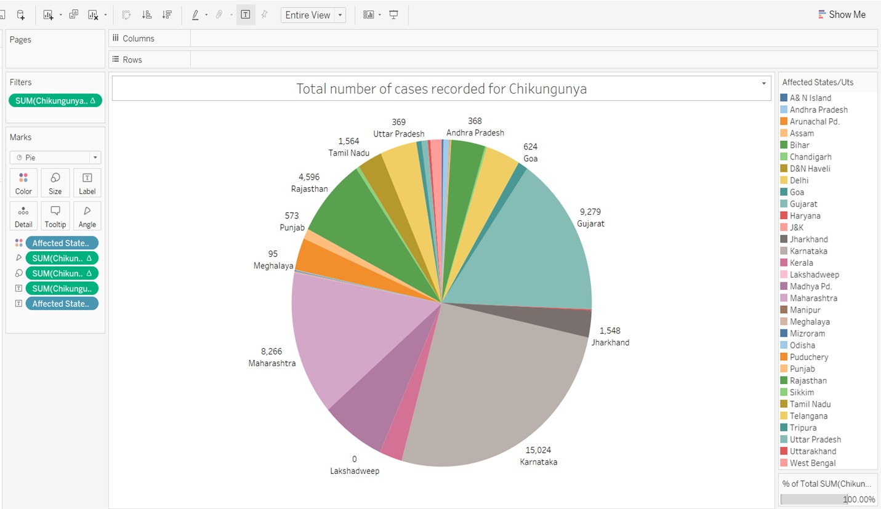

Slide 41




Total number of deaths due to Dengue Maximum deaths recorded in: - Maharashtra (206)
Total number of deaths due to Dengue from 2017 to 2022
Total no. of deaths recorded in india in 2017: - 325
Total no. of deaths recorded in india in 2022: - 86

Slide 43
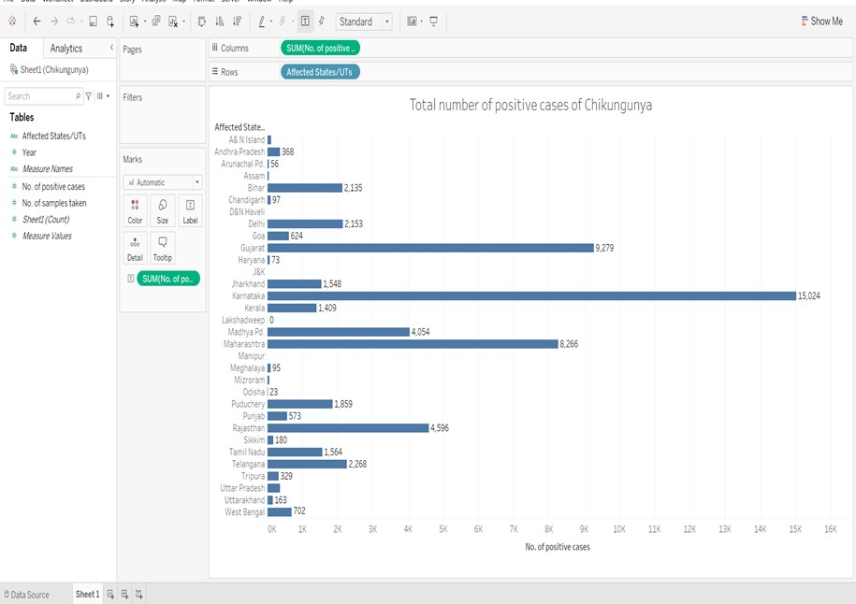

Slide 44

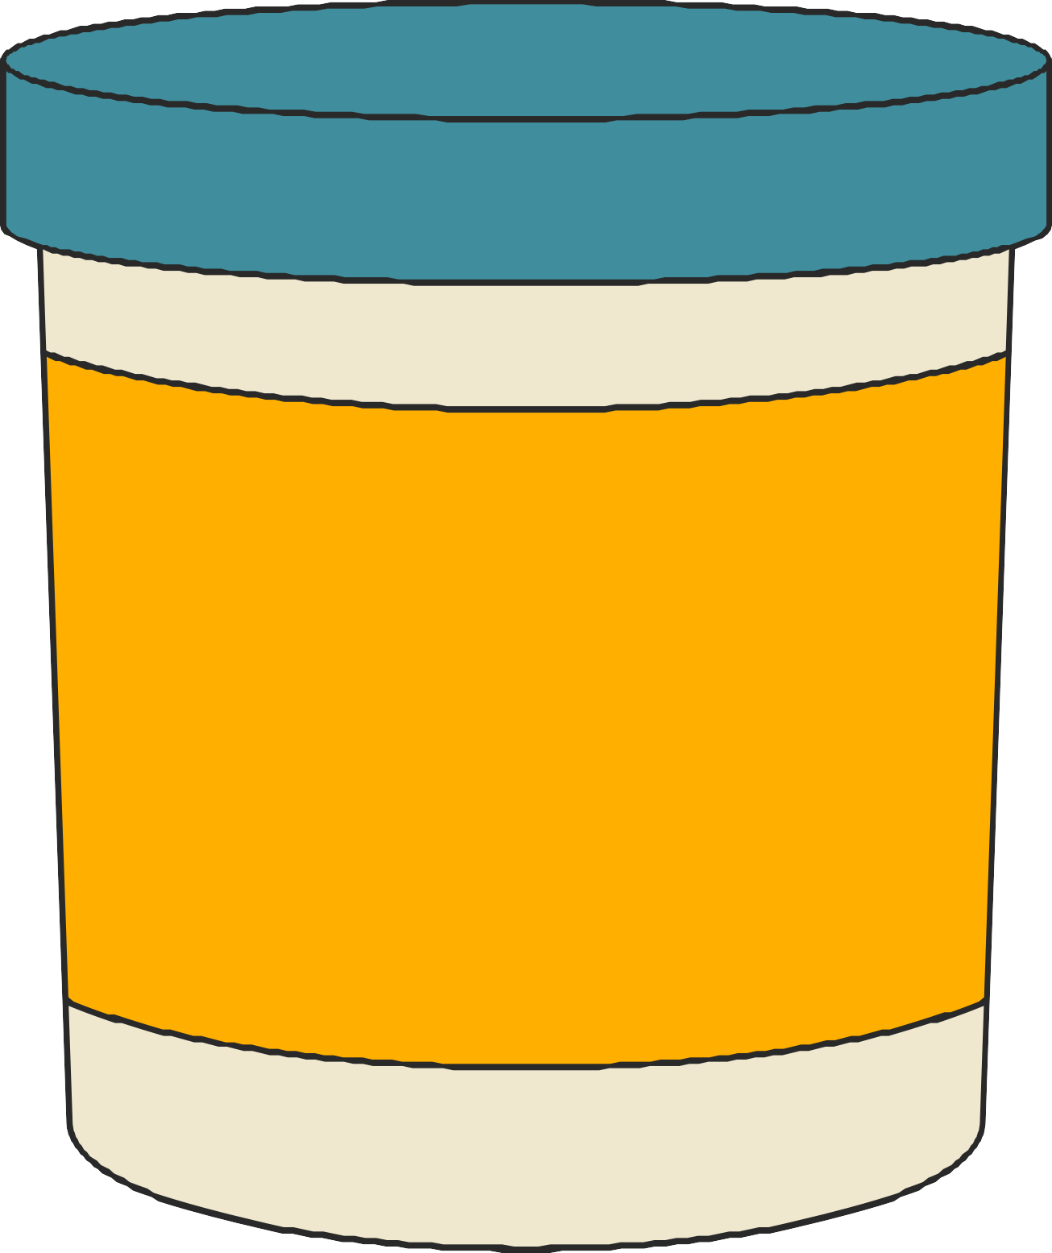
DASHBOARD

Slide 45
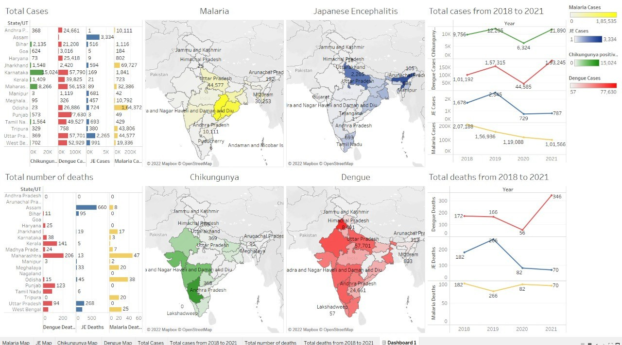

Slide 46
CONCLUSION
Malaria: -
Most affected state:
Chhattisgarh
Least affected state:
Sikkim
Japanese
Encephalitis: -
Most affected state:
Assam
Least affected state: -
Andhra Pradesh
Chikungunya: -
Most affected state:
Karnataka
Least affected state:
Manipur
Dengue: -
Most affected state: -
Punjab
Least affected state: -
Arunachal Pradesh

Slide 47
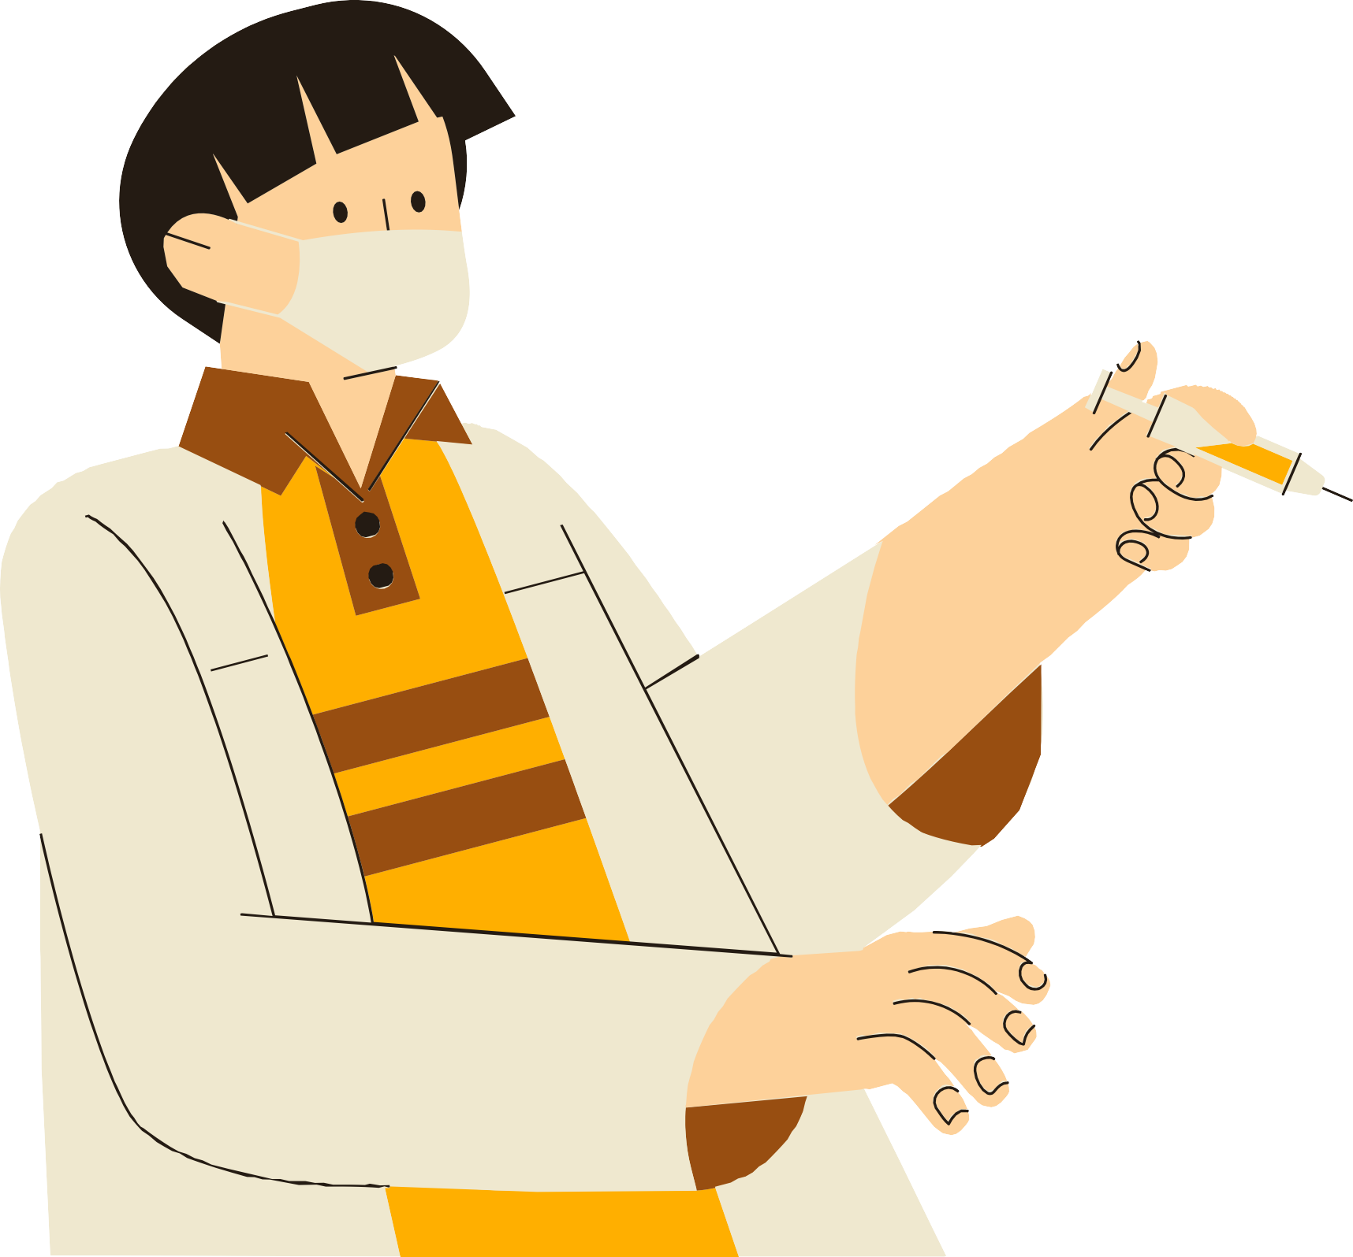




Thank you for
listening!

